Slide 1
Visualizing Weather Data in 3d
Dan Weitman, Tony Cicero

Slide 2



Technologies
Unity
3D visualization of data
Python
Downloading Data
Parsing Data
SQLite
Database for Storing data

Slide 3
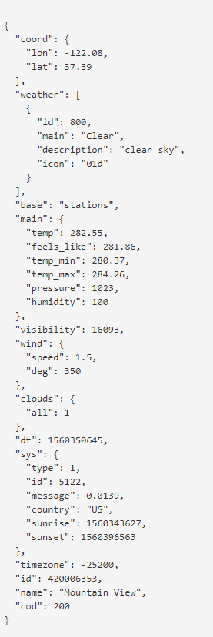
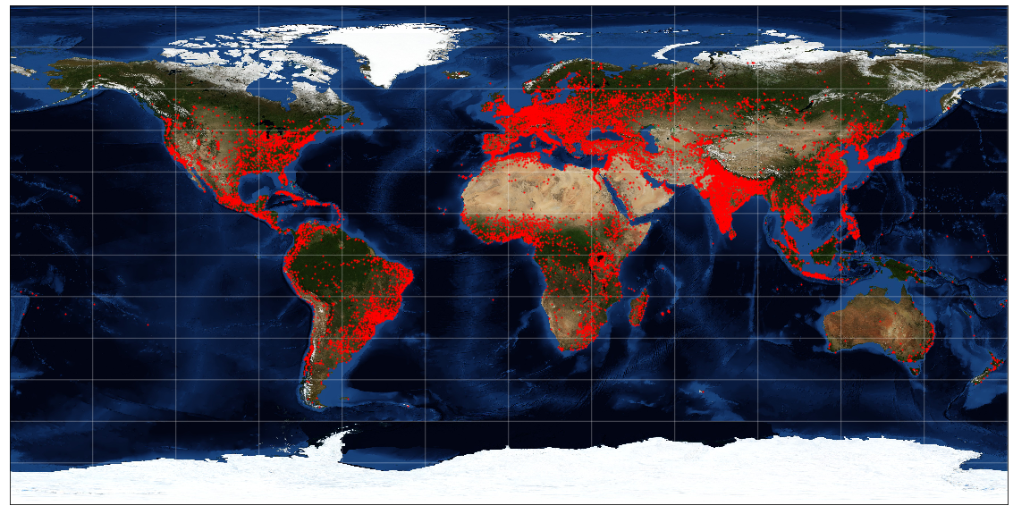
The Data
import json
import requests
import sqlite3
import time
import numpy as np
import matplotlib.pyplot as plt
from itertools import chain
#api key
appid = ''
with open('appid.data', 'r') as file:
appid = file.read().replace('\n', '')
#USA-48 LAT25~50; LONG -125~-70
startTime = time.time()
cpm = 0
calls = 0
entries = 0
SA = [-90,90,-180,180] #StudyArea- minLat,maxLat,minLon,maxLon
#lonL = -80
#latB = 35
#lonR = -75
#latT = 40
zoom = 10
#http://api.openweathermap.org/data/2.5/box/city?bbox=90,70,50,30,10&appid=09526e5c10271a3d65e467120606b982
#url = "http://api.openweathermap.org/data/2.5/box/city?bbox={0},{1},{2},{3},{4}&appid={5}".format(lonL,latB, lonR, latT, zoom, appid)
#sqlite3 database connection
conn = sqlite3.connect('WorldWeather.db')
c = conn.cursor()
sql_transaction = []
def get_data(lonL,latB,lonR,latT):
global calls
global cpm
global startTime
global data
time.sleep(1)
url = "http://api.openweathermap.org/data/2.5/box/city?bbox={0},{1},{2},{3},{4}&appid={5}".format(lonL,latB, lonR, latT, zoom, appid)
response = requests.get(url)
data = response.json()
calls += 1
cpm = calls/((time.time()-startTime)/60)
print ("Data calls: ", calls, "| CPM: ",cpm)
def create_table():
c.execute("""CREATE TABLE IF NOT EXISTS weather
(location TEXT, Lat INT, Lon INT,
temp FLOAT, wind FLOAT, windDeg FLOAT,
visibility INT, pressure FLOAT, humidity INT,
clouds INT, weatherID INT, fetchTime INT, setID INT)""")
def sql_insert_data(loc, lat, lon, tmp, wind, windDeg, visi, pres, humi, cloud, wid, ftime, setID):
try:
sql = """INSERT INTO weather (location, Lat, Lon, temp, wind, windDeg, visibility, pressure, humidity, clouds, weatherID, fetchTime, setID) VALUES ("{}","{}","{}","{}","{}","{}","{}","{}"); """.format(loc, lat, lon, tmp, wind, windDeg, visi, pres, humi, cloud, wid, ftime, setID)
transaction_bldr(sql)
except Exception as e:
print('Data Insertion', e)
def transaction_bldr(sql):
global entries
entries += 1
global sql_transaction
sql_transaction.append(sql)
if len(sql_transaction) >= 100:
print ("Sent total of ",entries, " entries to DB")
c.execute('BEGIN TRANSACTION')
for s in sql_transaction:
try:
c.execute(s)
except Exception as e:
#print("Transaction: ", e)
pass
conn.commit()
sql_transaction = []
def draw_map(m, scale=0.2):
global SA
# draw a shaded-relief image
m.bluemarble()
# lats and longs are returned as a dictionary
lats = m.drawparallels(np.linspace(SA[0], SA[1], 13))
lons = m.drawmeridians(np.linspace(SA[2], SA[3], 13))
# keys contain the plt.Line2D instances
lat_lines = chain(*(tup[1][0] for tup in lats.items()))
lon_lines = chain(*(tup[1][0] for tup in lons.items()))
all_lines = chain(lat_lines, lon_lines)
# cycle through these lines and set the desired style
for line in all_lines:
line.set(linestyle='-', alpha=0.3, color='w')
while (True):
startTime = time.time()
#print data["list"][0]["name"] #location name
#print data["list"][0]["coord"]["Lat"] #Latitude
#print data["list"][0]["coord"]["Lon"] #Longitude
#print data["list"][0]["main"]["temp"] #temperature (in celsius)
#print data["list"][0]["main"]["pressure"] #pressure
#print data["list"][0]["main"]["humidity"] #humidity
#print data["list"][0]["weather"][0]["id"] #Weather id
#print time.time()
#print count
create_table()
x = -180
y = -90
for y in range(SA[0],SA[1],5):
for x in range(SA[2],SA[3],5):
get_data(x,y,x+5,y+5)
#print (data)
if data:
count = data["cnt"]
for i in range(count):
#print ("test")
loc = data["list"][i]["name"] #location name
lat = data["list"][i]["coord"]["Lat"] #Latitude
lon = data["list"][i]["coord"]["Lon"] #Longitude
temp = data["list"][i]["main"]["temp"] #temperature (in celsius)
wind = data["list"][i]["wind"]["speed"] #wind speed
windDeg = data["list"][i]["wind"]["deg"] #wind direction
visi = wind = data["list"][i]["visibility"] #visibility
pressure = data["list"][i]["main"]["pressure"] #pressure
humidity = data["list"][i]["main"]["humidity"] #humidity
cloud = data["list"][i]["clouds"]["all"] #cloud %
w_ID = data["list"][i]["weather"][0]["id"] #Weather id
plt.plot(lon, lat, 'ok', markersize=1,c='red')
#plt.text(lon, lat, loc, fontsize=12);
#loc, lat, lon, tmp, wind, windDeg, visi, pres, humi, cloud, wid, ftime, setID
sql_insert_data(loc, lat, lon, temp, wind, windDeg, visi, pressure, humidity, cloud, w_ID, time.time(), startTime)
print("Time Elapsed: ", time.time()-startTime)
conn.close()
Sample API JSON Response
https://openweathermap.org/

Slide 4
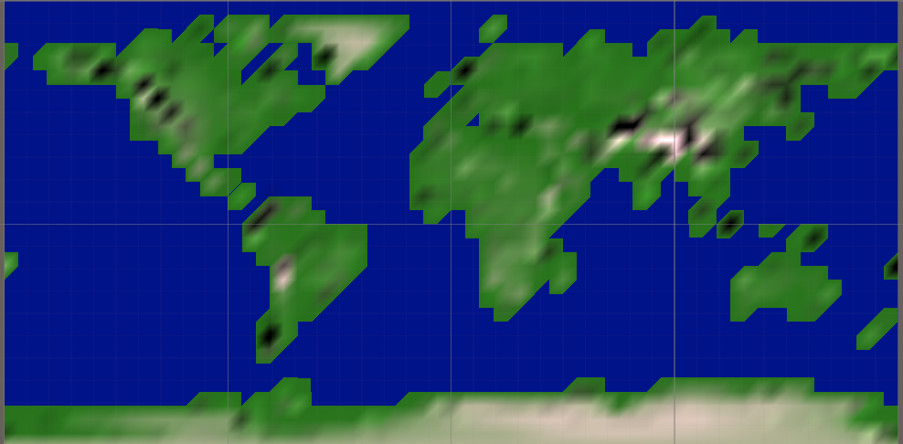
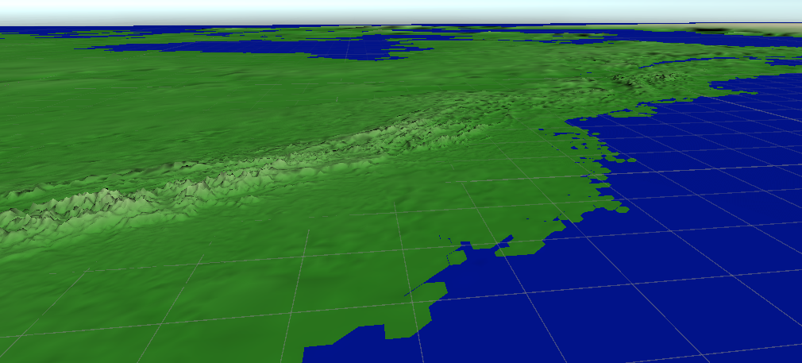
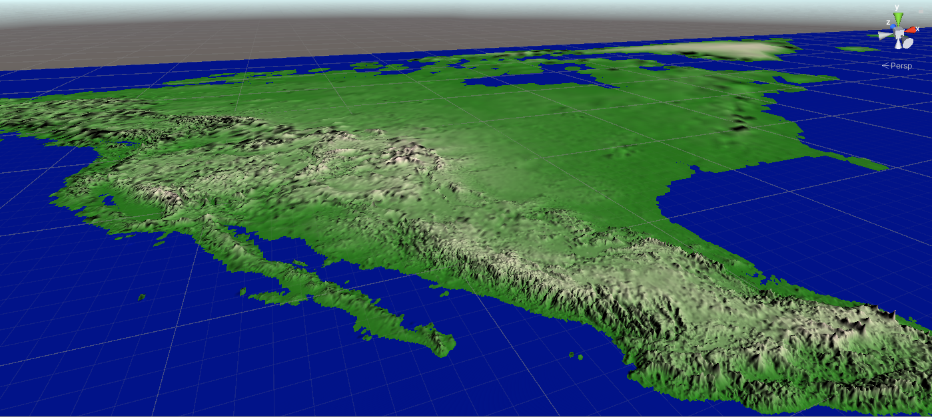
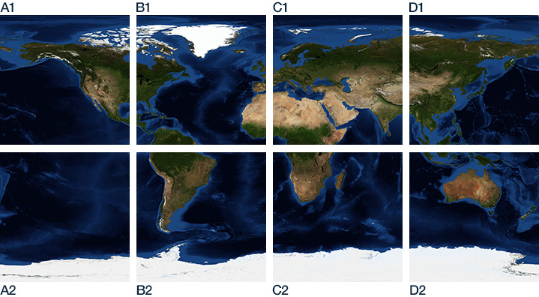
Visualization
Using real-world heightmaps from https://visibleearth.nasa.gov/images/73934/topography
Equirectangular Projection https://visibleearth.nasa.gov/grid

